Slide 1
Meeting Room Booking Management System
This presentation will give you details overview of my project.
Md Mezbahul Islam
Trainee Software Engineer
OnnoRokom Projukti Limited

Slide 2
Agenda and Core Functionalities in a Brief
Agenda
Core Functionalities
Manage meeting rooms and facilities.
Simplify the booking meeting rooms.
Registered users can request for bookings through the Event Calendar.
Admin will accept/ reject/ update the bookings.
For a same time duration A user can not book multiple rooms.

Slide 3
Project steps at a glance
Three Tier Architecture and Layout Design
Manage Facilities (CRUD)
Manage Rooms (CRUD)
Initialized the Event Calendar
Manage Bookings (Calendar & Manual Button)
Authentication and Authorization
Search, Sort, Pagination
Logger (Built-in & Third-Party)
Requirement Gathering
SRS
FRS
UI
WorkFlow
FRS Implementation
Database Design
Implementation Started
Continue

Slide 4
FRS Provided: Features are Implemented in the existing Project:
User Registration CSV Bulk Insert
Multiple Image upload
QR Code for the particular room
Custom pop-up
Identity User Manipulation (sign-in via Pin)
Default Calendar View: Weekly
Features that need to be implemented:
Image Preview
Forget Password
Password Expiration
Disable Meeting

Slide 5
Technologies are used in this project
C# (v10.0)
jQuery (v3.6.0)
Bootstrap (v5.1.0) & HTML 5
MSSQL (v9.0.0)
.NET 8
Entity Framework Core
Three Tier Architecture
JS Event Calendar (Open Source)
EF Core Identity, Serilog
CsvReader, QRCoder
TortoiseGit, GitLab

Slide 6
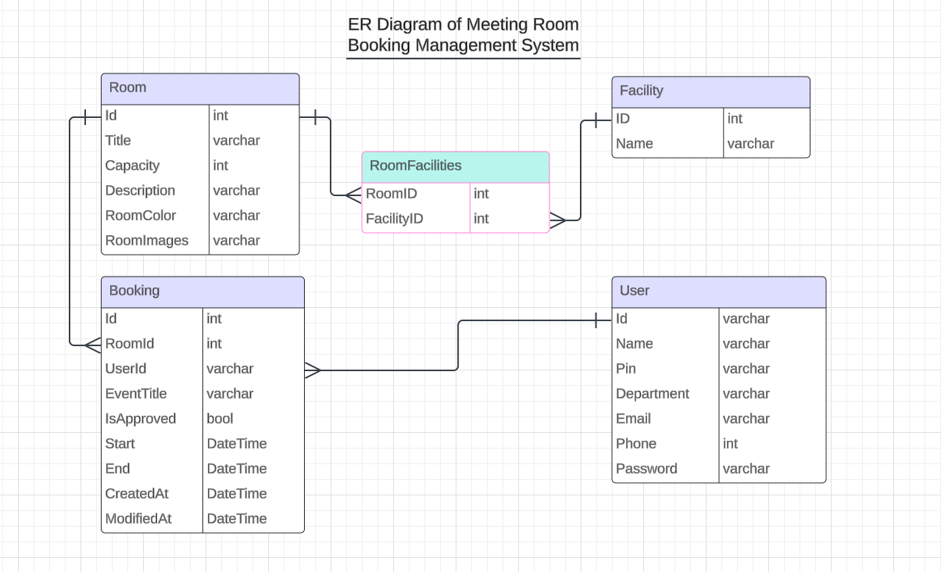
Entity Relationship Diagram

Slide 7
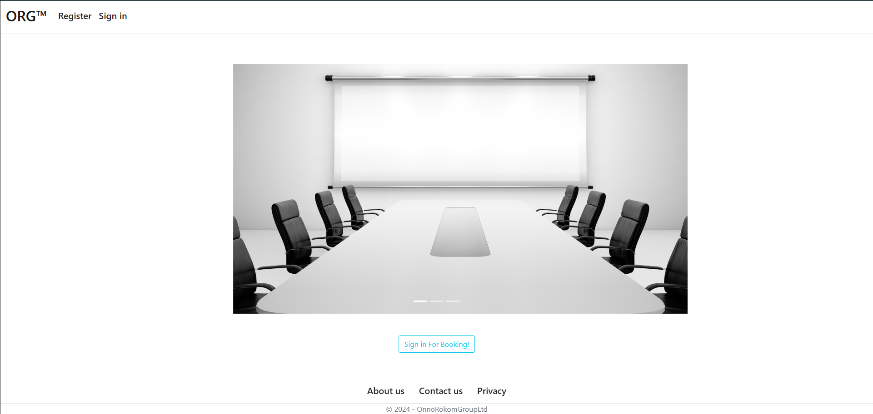

Slide 8
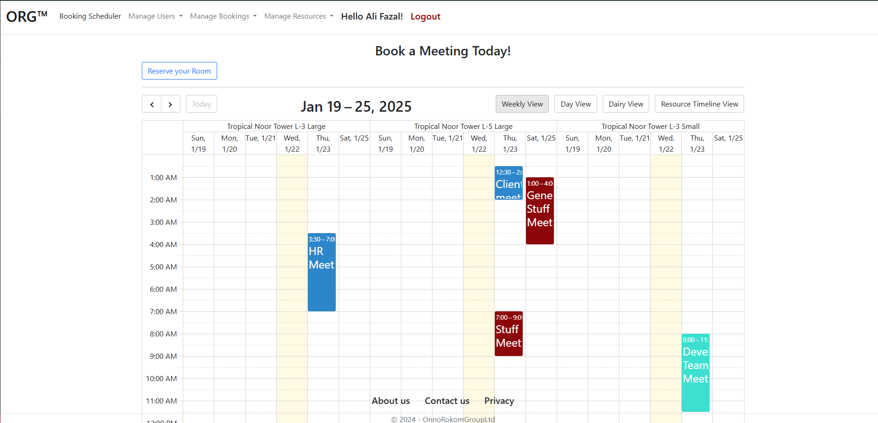
Registered User: Booking Calendar Default View: Weekly

Slide 9
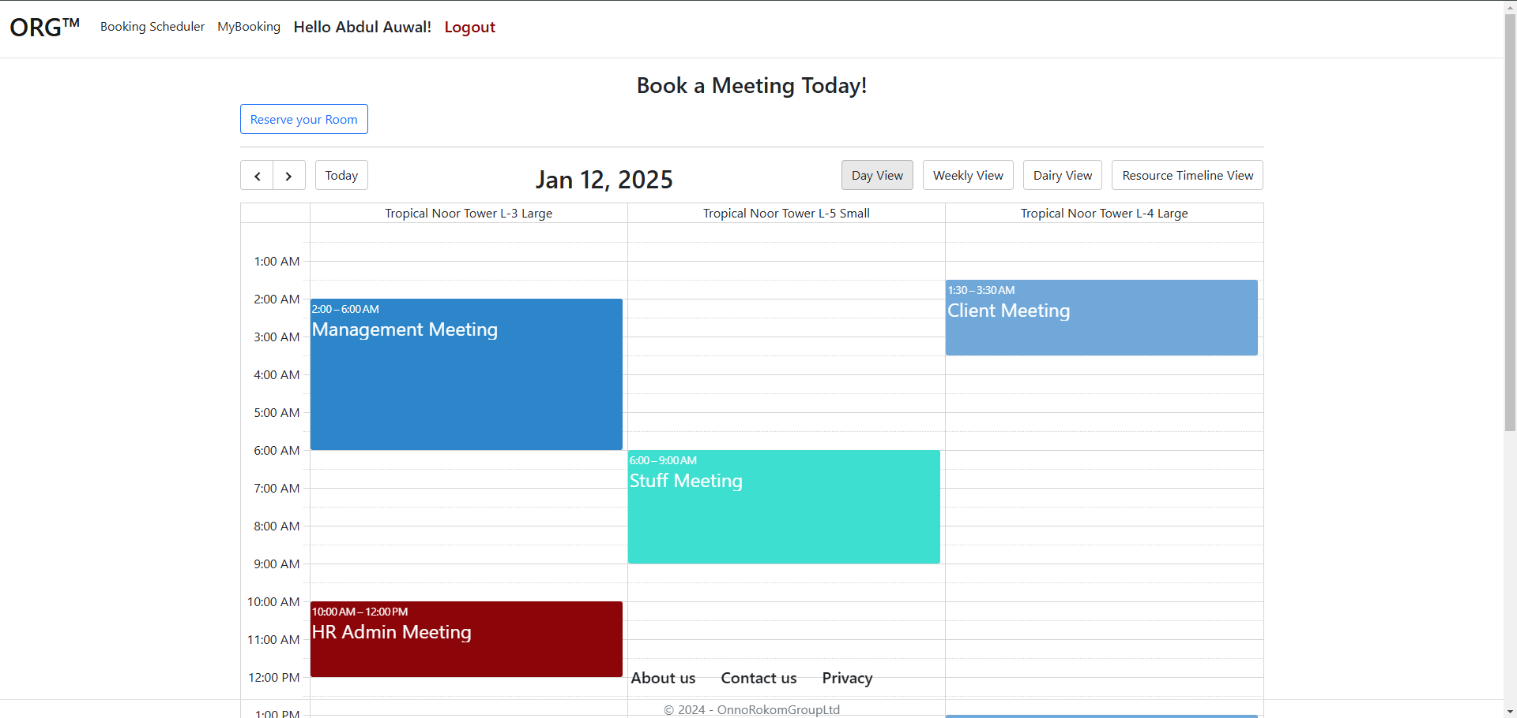
Booking Calendar Day View

Slide 10
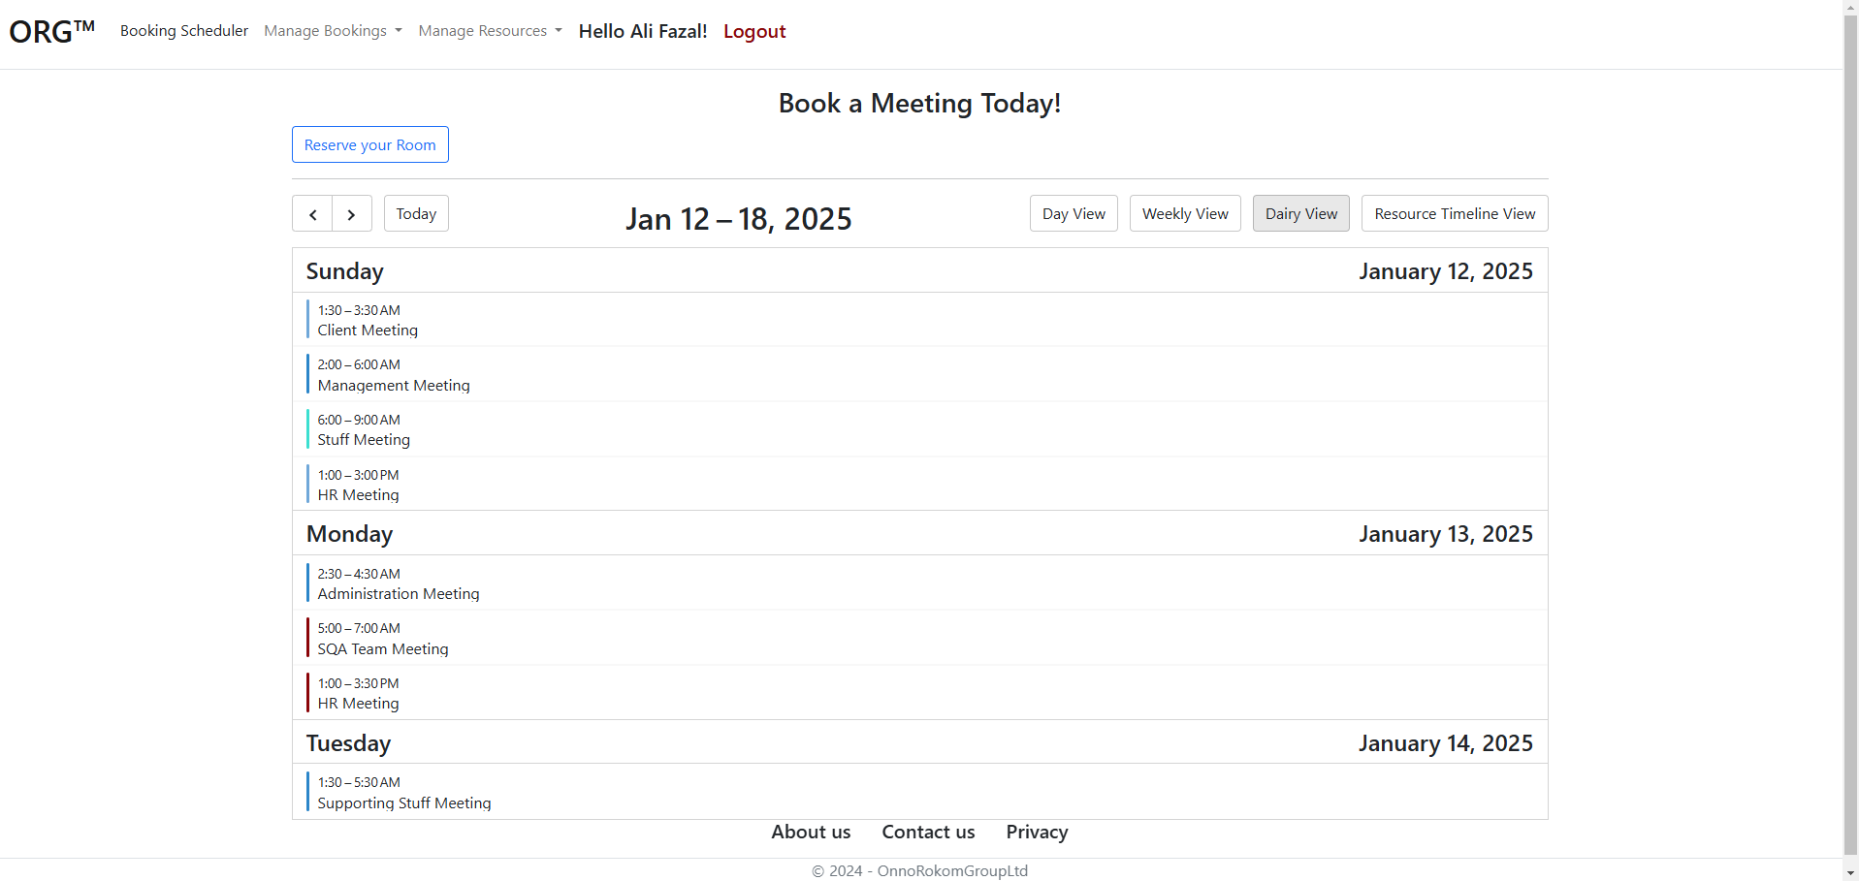
Booking Calendar weekly Diary View

Slide 11
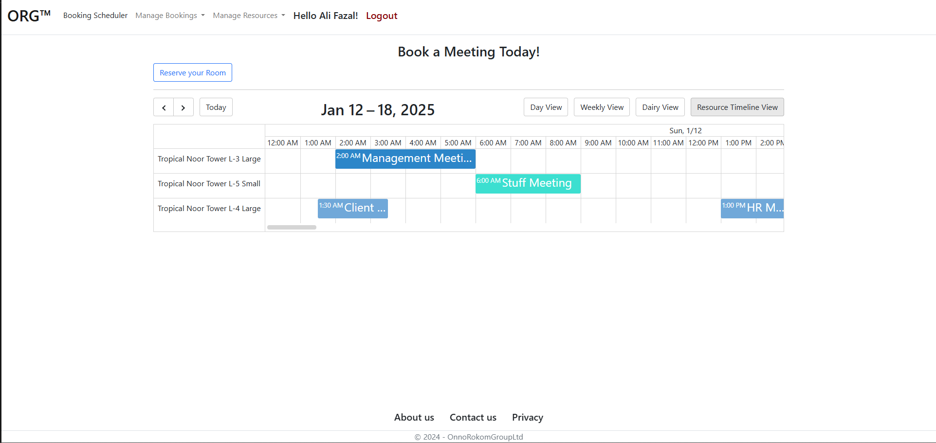
Booking Calendar Room View

Slide 12
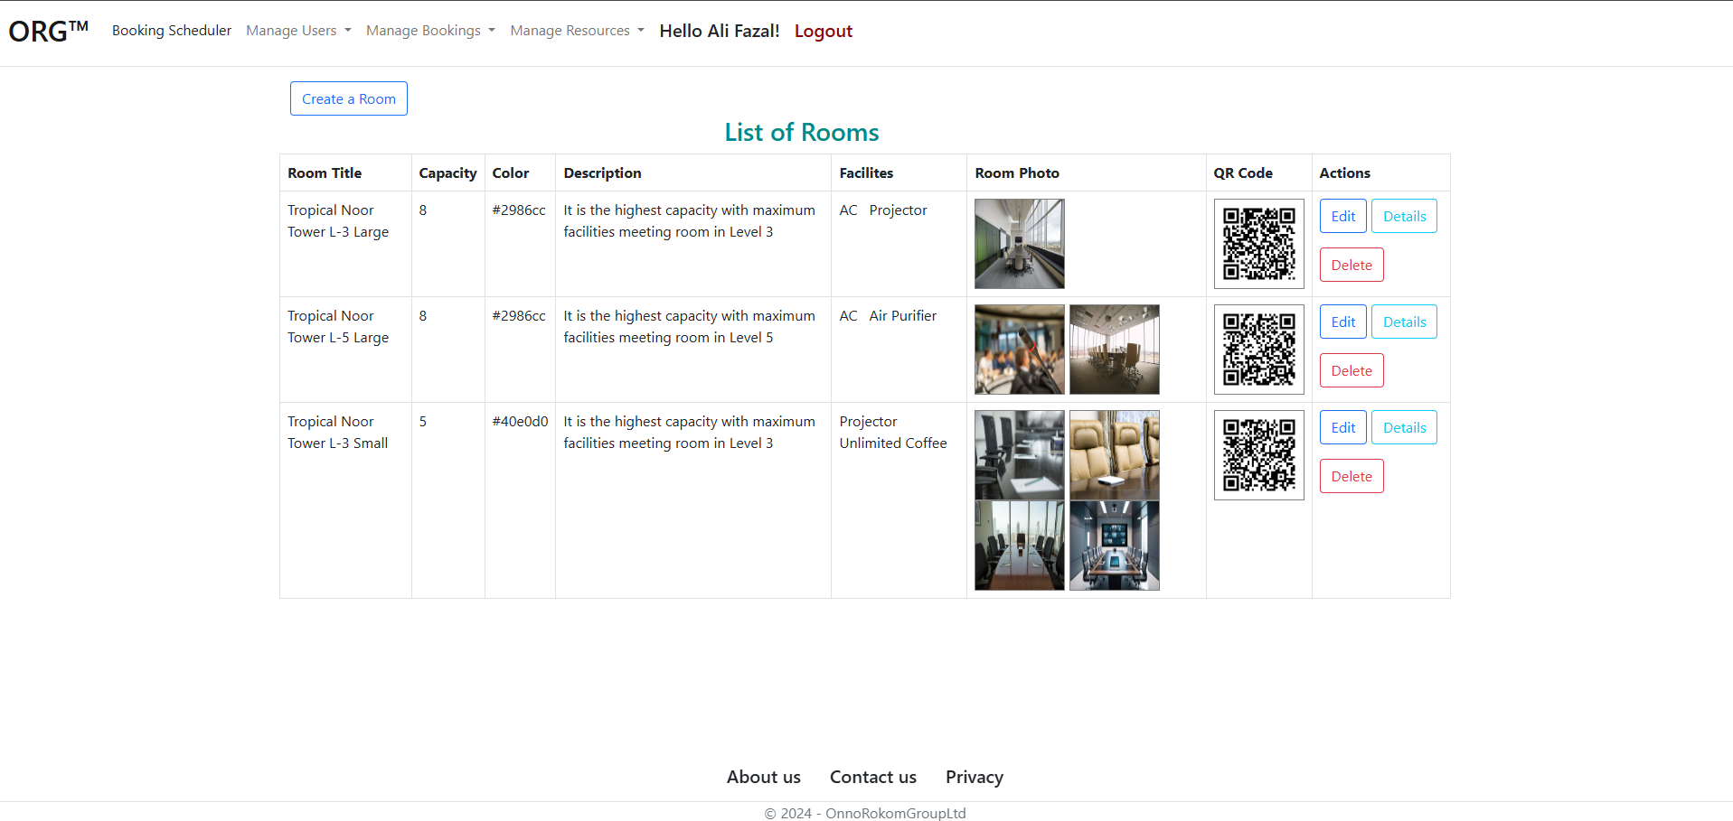
Admin: Resource Management (Rooms, Facilities)

Slide 13
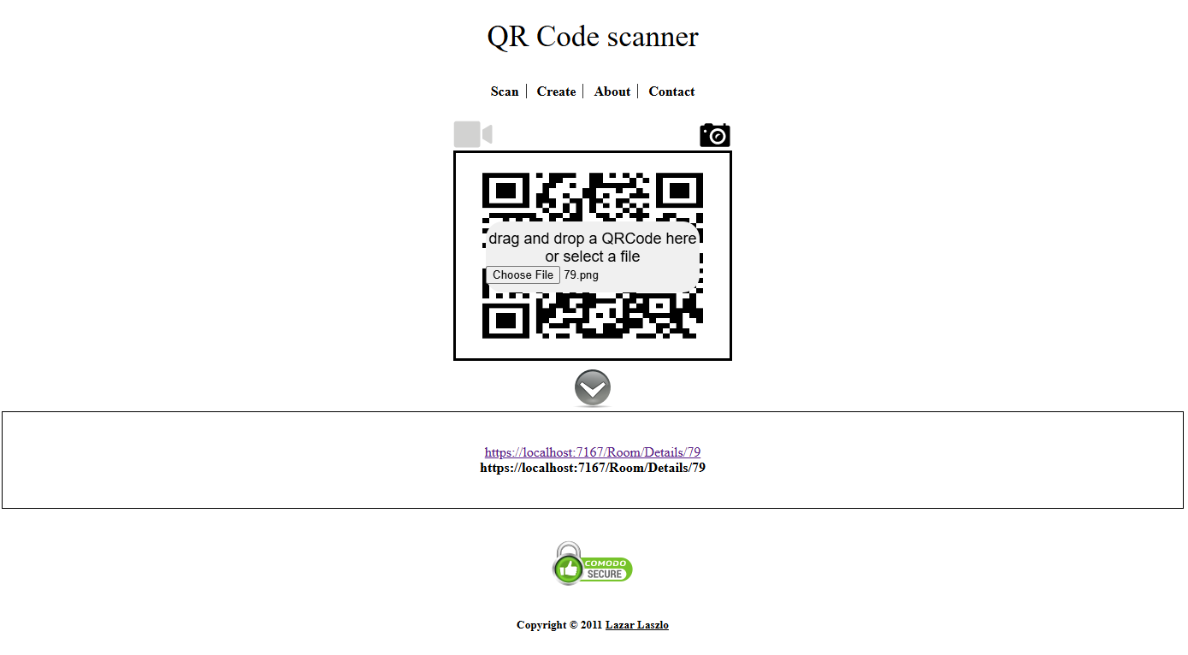
QR Code Scanned

Slide 14
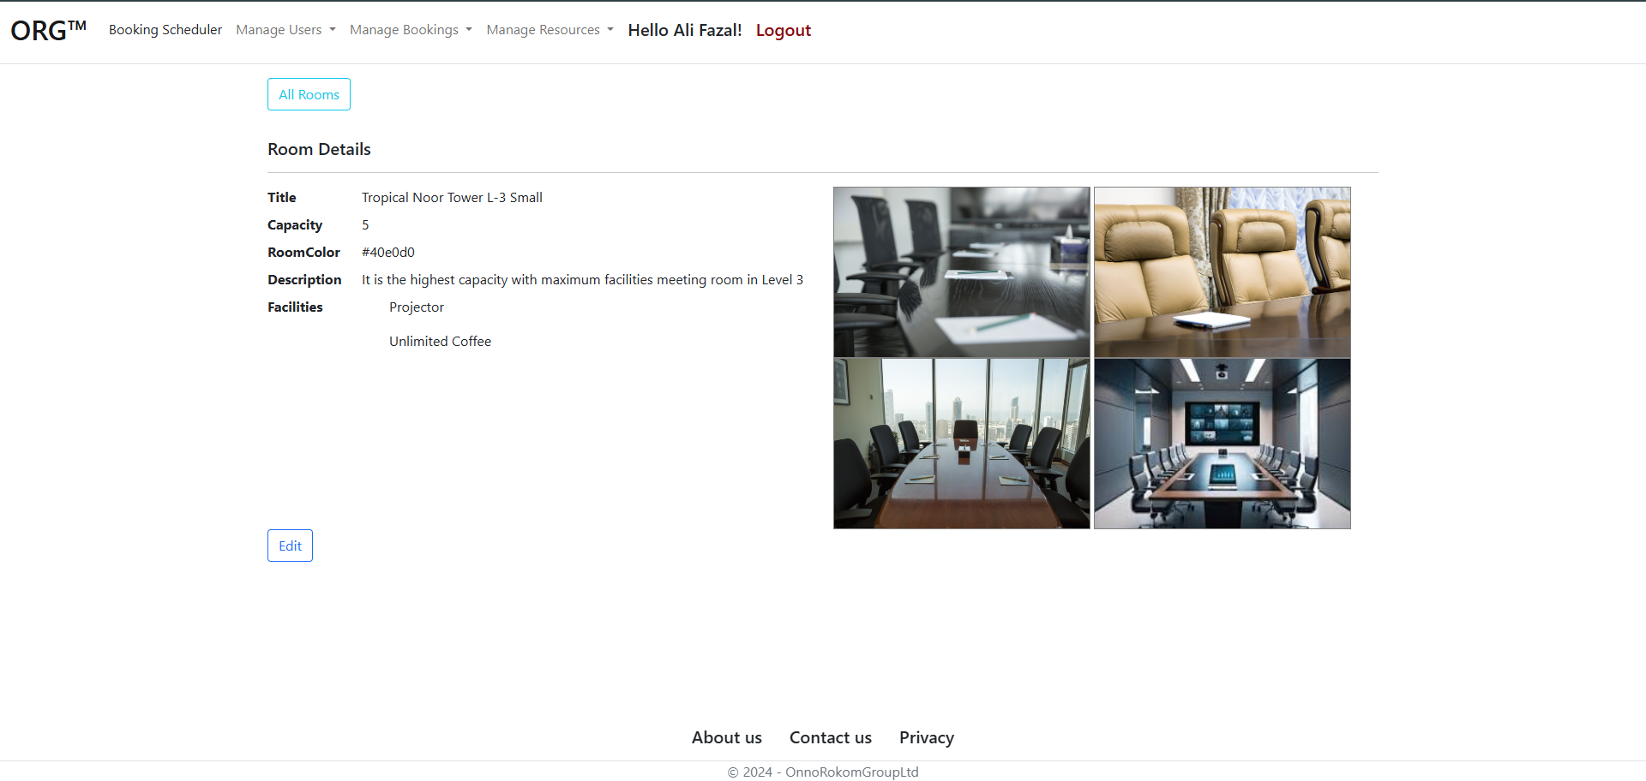
Room Details View

Slide 15
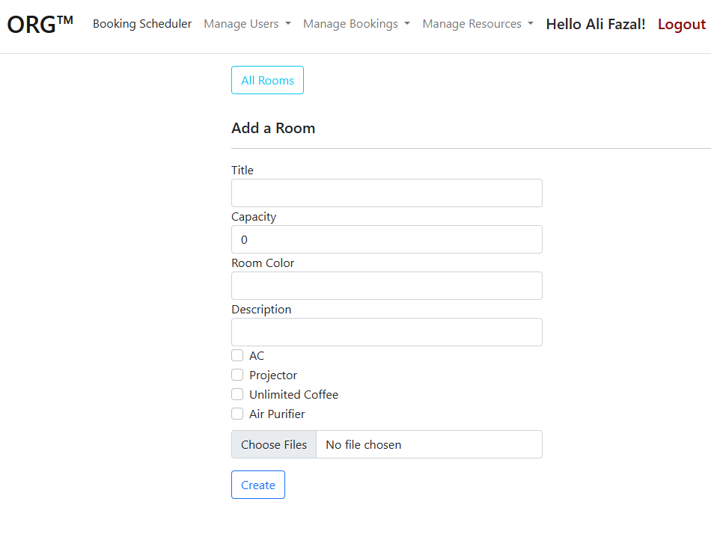
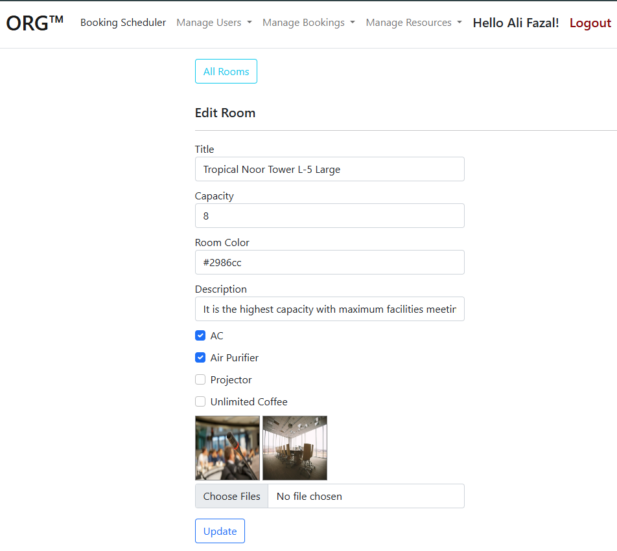
Room Create
Room Edit

Slide 16
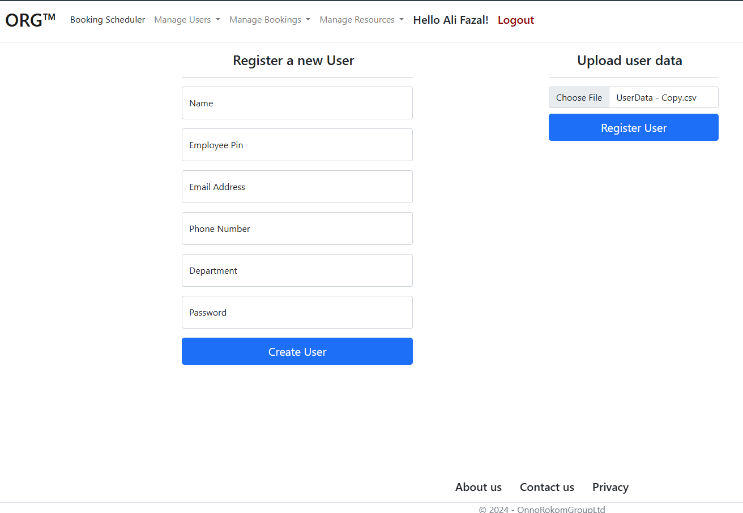
User Management: Create User

Slide 17
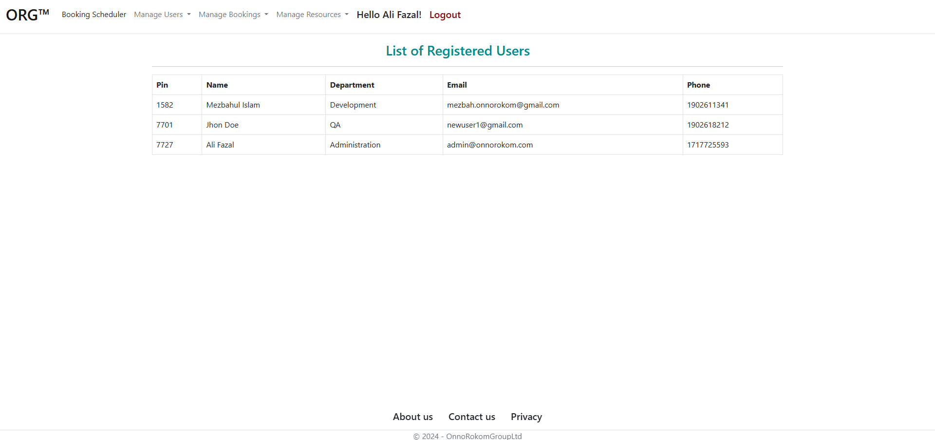
User Management: All User

Slide 18
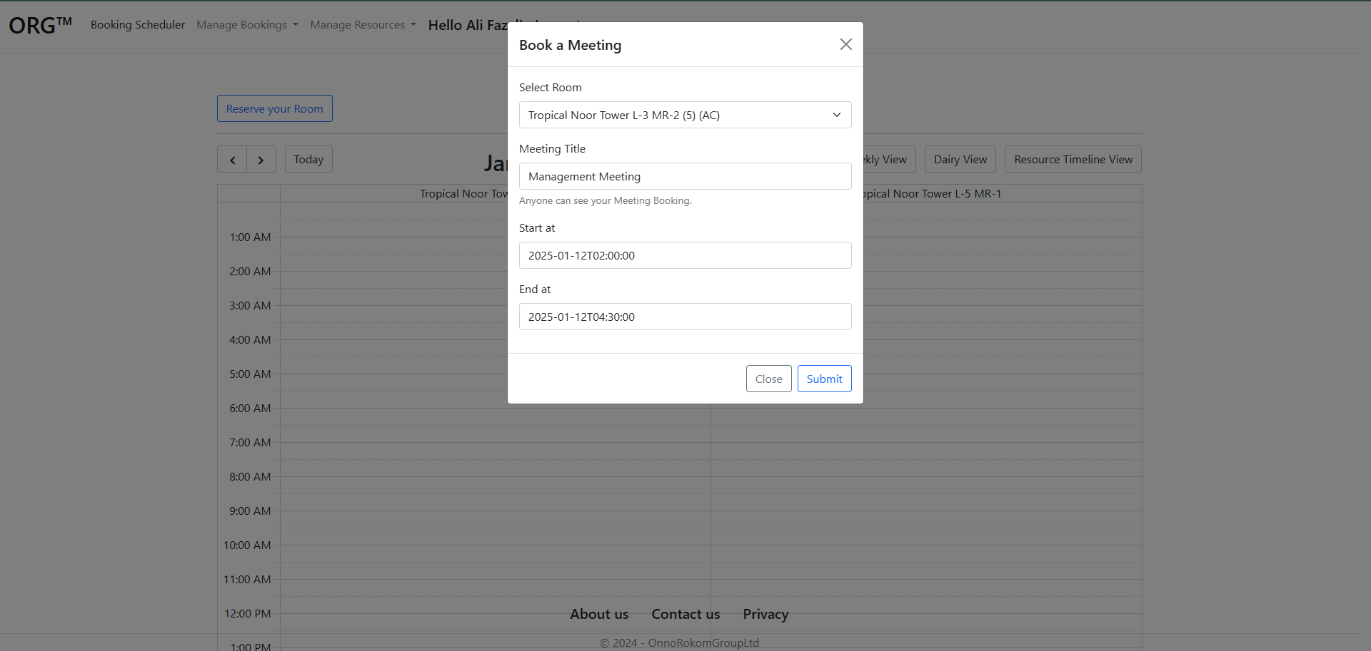
Booking Create: Calendar Drag or Time Select

Slide 19
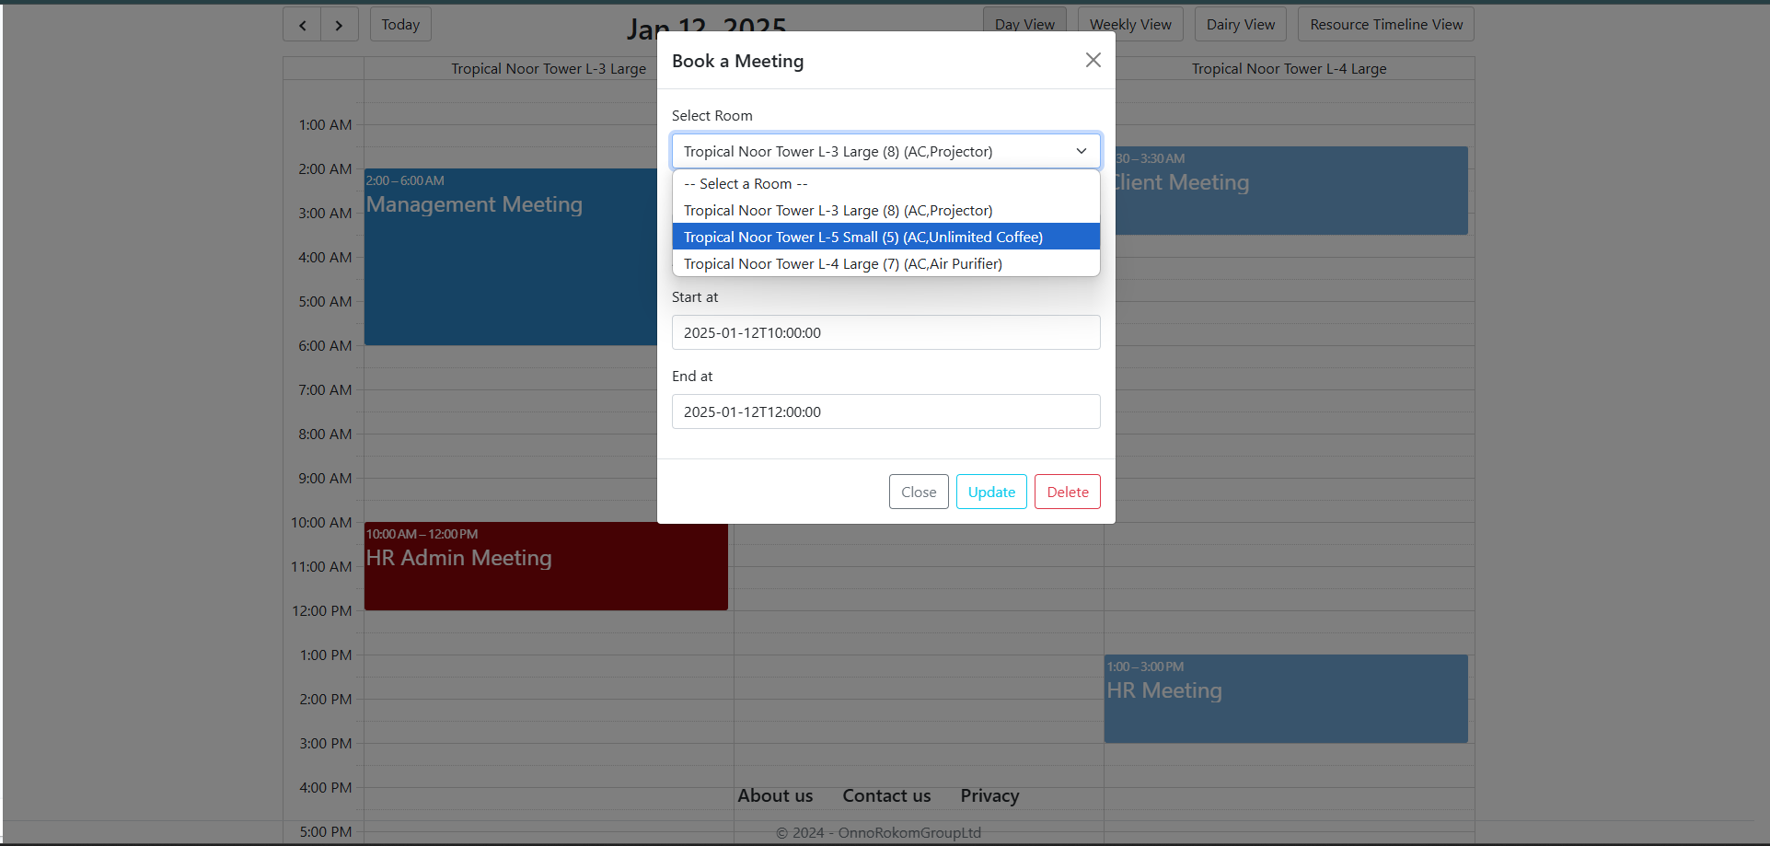
Booking Update

Slide 20
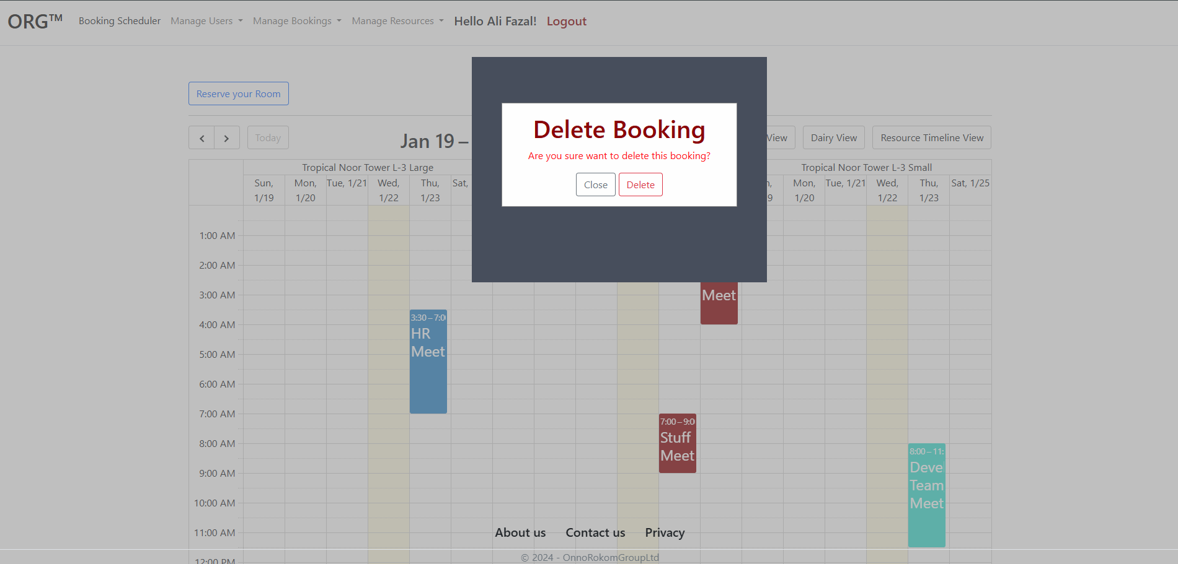
Delete Confirmation Custom pop-up

Slide 21
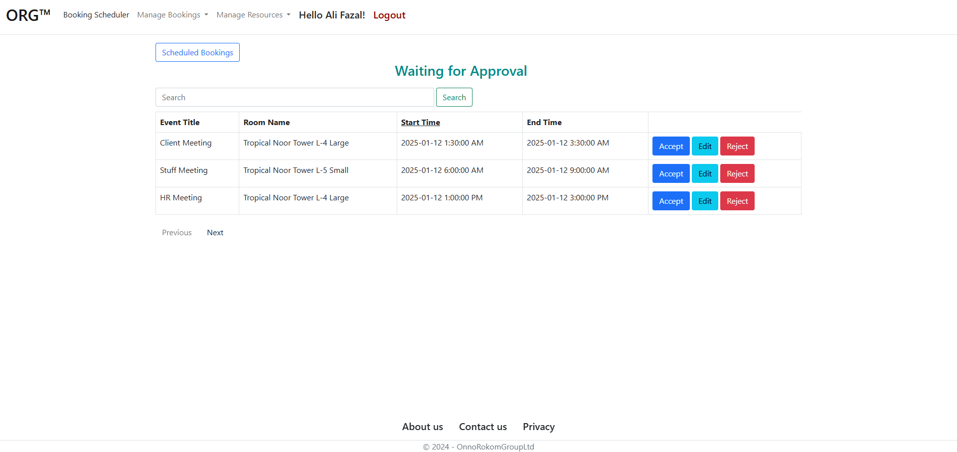
Requested Bookings in Admin Dashboard

Slide 22
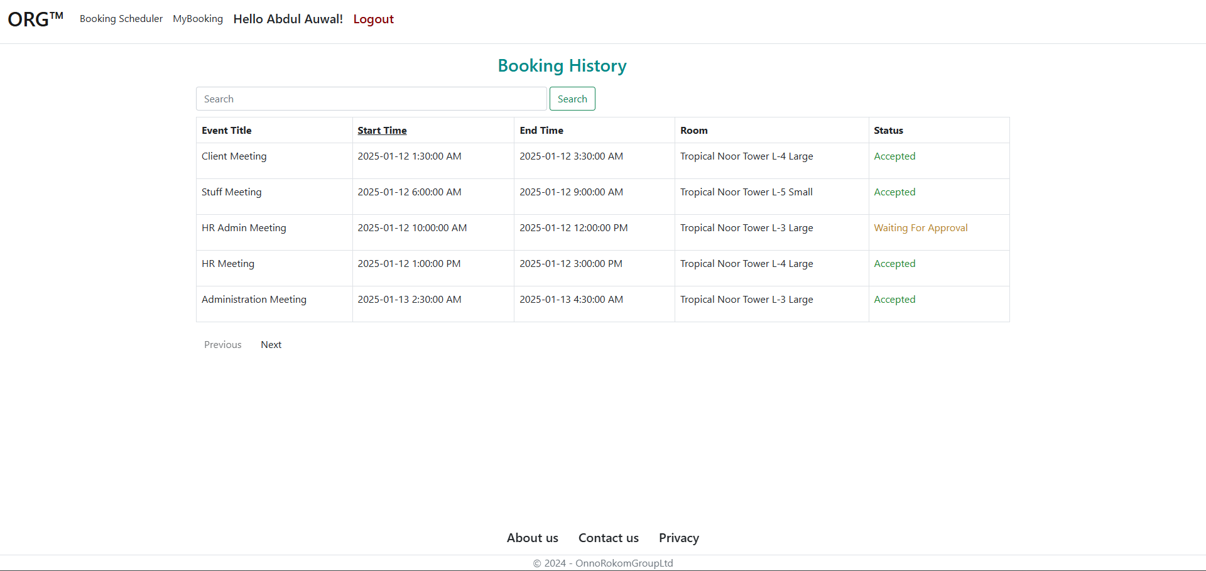
User Bookings History in User Dashboard

Slide 23
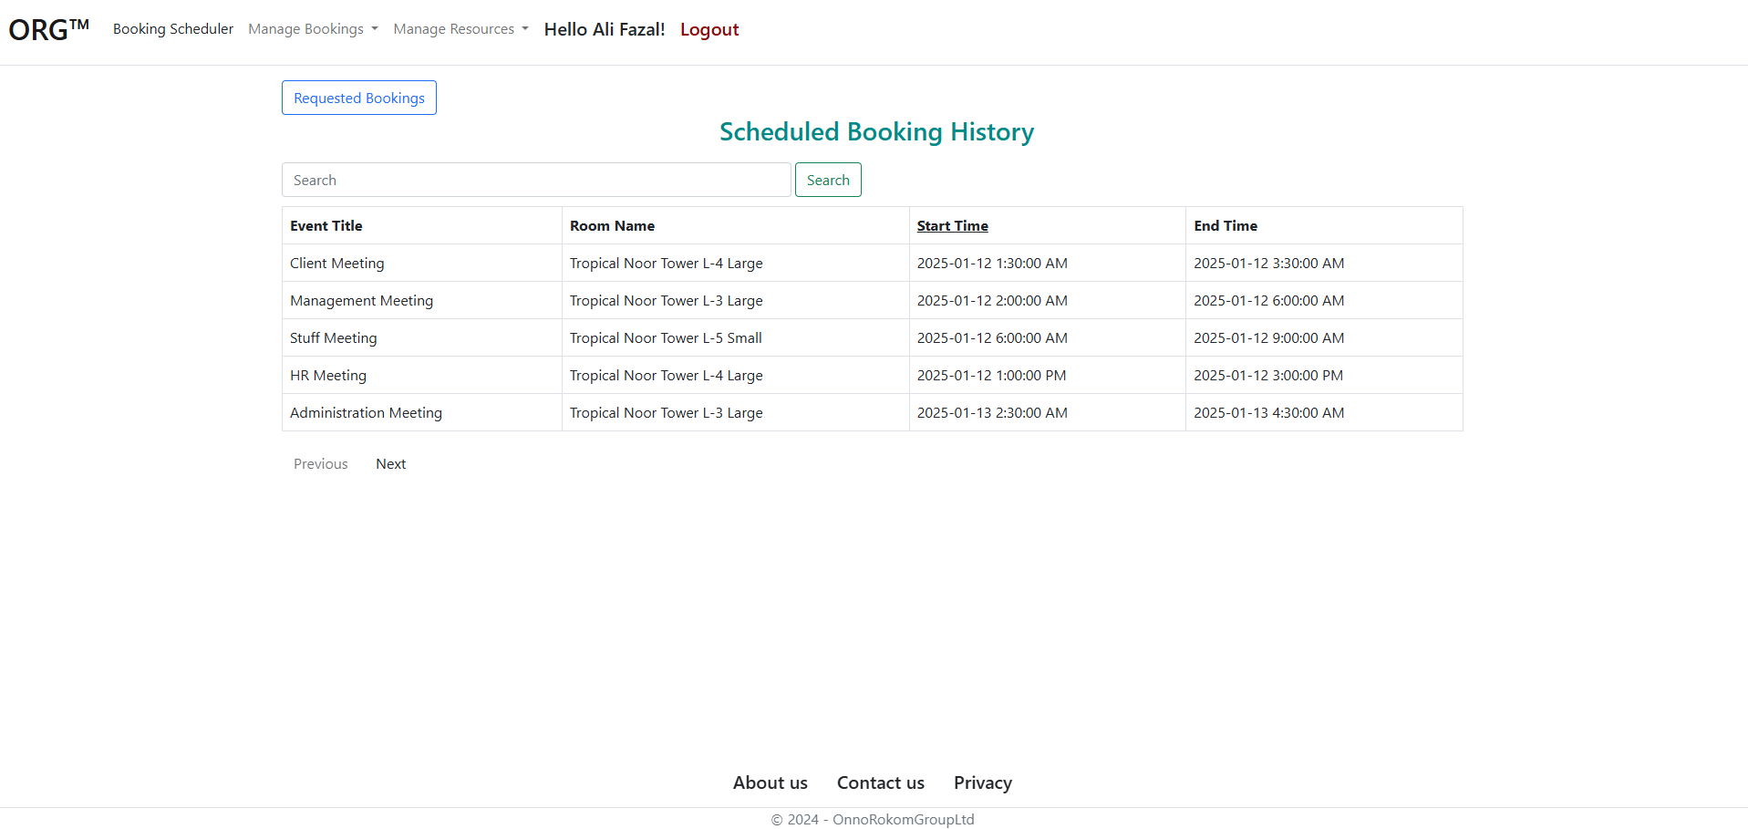
All Scheduled Bookings in Admin Dashboard

Slide 24
Thank You

